Slide 1

21CSC205P Database Management Systems

Slide 2
Outline of the Presentation
Conversion of ER model to Relational Table
Case study: Apply conversion concept. Discussion of various design issues
Pitfalls in Relational Database systems
Understanding various Relational languages such as
Tuple Relational calculus,
Domain relational calculus,
Calculus Vs Algebra,
Computational capabilities.
Case Study: Applying Relational Algebra for all the queries of application Designed.

Slide 3
Conversion of ER to Relational Table
After completing the ER diagram
ER diagram is converted into the tables in relational model
Relational model can be easily implemented in ORACLE, MYSQL , etc.,
The below points to be considered for converting ER diagram into tables.
Strong Entity Set With Only Simple Attributes
Strong Entity Set With Composite Attributes
Strong Entity Set With Multi Valued Attributes
Translating Relationship Set into a Table
Binary Relationships With Cardinality Ratios
Binary Relationship With Both Cardinality Constraints and Participation Constraints
Binary Relationship With Weak Entity Set

Slide 4
Conversion of ER to Relational Table
Strong Entity Set With Only Simple Attributes
A strong entity set with only simple attributes will require only one table in relational model.
Attributes of the table will be the attributes of the entity set.
The primary key of the table will be the key attribute of the entity set.
ER DIAGRAM
Er Diagram to relational table
RELATIONAL TABLE
REG_NO
NAME
REG_NO | NAME | DOB
STUDENT
DOB
Schema : student (reg_no, name, dob)

Slide 5
Conversion of ER to Relational Table
Strong Entity Set With Composite Attributes
A strong entity set with any number of composite attributes will require only one table in relational model.
While conversion, simple attributes of the composite attributes are taken into account and not the composite attribute itself.
ER DIAGRAM
Er Diagram to relational table
RELATIONAL TABLE
F_NAME
L_NAME
Reg_no | F_name | L_name | dno | street | city
REG_NO
NAME
STUDENT
Street
Schema : student (reg_no, f_name, l_name, dno, street, city)
Dno
address
city

Slide 6
Conversion of ER to Relational Table
Strong Entity Set With Multi Valued Attributes
A strong entity set with any number of multi valued attributes will require two tables in relational model.
One table will contain all the simple attributes with the primary key.
Other table will contain the primary key and all the multi valued attributes.
ER DIAGRAM
Er Diagram to relational table
RELATIONAL TABLE
REG_NO
NAME
REG_NO | NAME
REG_NO | Phone_no
STUDENT
Phone_no
Schema : student (reg_no, name)
Schema : student (reg_no, phone_no)

Slide 7
Conversion of ER to Relational Table
Strong Entity Set With Multi Valued Attributes
Also the stronger entity set with any number of multi valued attributes may be converted as shown below
ER DIAGRAM
Er Diagram to relational table
RELATIONAL TABLE
REG_NO
NAME
reg_no | name | phone_no1 | phone_no2 | Phone_no3
STUDENT
Phone_no
Schema : student (reg_no, name, phone_no1 ,phone_no2, phone_no3)

Slide 8
Conversion of ER to Relational Table
Translating Relationship Set into a Table
A relationship set will require one table in the relational model.
Attributes of the table are :
Primary key attributes of the participating entity sets
Its own descriptive attributes if any.
Set of non-descriptive attributes will be the primary key.
NOTE
If we consider the overall ER
diagram, three tables will be
required in relational model
1. Emp
2. Dept
3.Works_in
ER DIAGRAM
Er Diagram to relational table
RELATIONAL TABLE
Date_of _join
empno
ename
Dept_id
dname
empno | dept_id | date_of_join
Works_in
emp
dept
salary
Schema : works_in (empno, dept_id, date_of_join)

Slide 9
Conversion of ER to Relational Table
Binary Relationships With Cardinality Ratios
Four types are possible
Binary relationship with cardinality ratio 1:1
Binary relationship with cardinality ratio 1:m
Binary relationship with cardinality ratio m:1
Binary relationship with cardinality ratio m:m

Slide 10
Conversion of ER to Relational Table
Mapping Cardinality
The relationship set counselor, between the faculty and student entity sets may be one-to-one, one-to-many, many-to-one, or many-to-many.
To distinguish among these types, we draw either a directed line ( → ) or an undirected line ( — ) between the relationship set and the entity.
Binary Relationships With Cardinality Ratios
Binary relationship with cardinality ratio 1:1
Line from the relationship set counselor to both entity sets faculty and student as given in the figure below. This indicates that a faculty may counsel at most one student, and a student may have at most one counselor.
FACULTY
Faculty_ID Faculty_Name Faculty_Designation Faculty _Sal Faculty_DOB Faculty_MobileNo Dept_ID
Counselor
Student
Student_RegNo Student_Name Student_DOB Student_Location Dept_ID

Slide 11
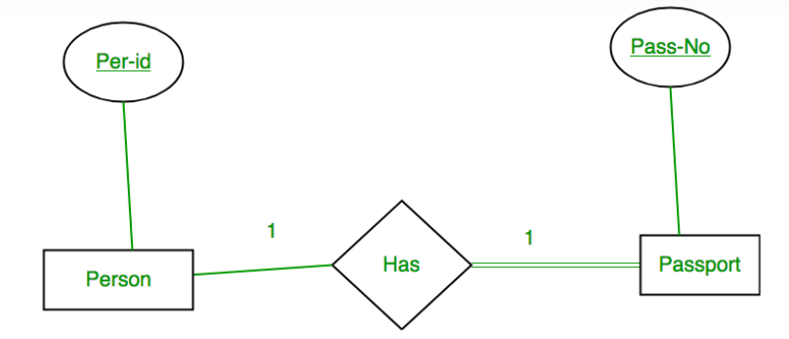
Binary relationship with cardinality ratio 1:1, total participation
Per-Id | Other Person Attribute | Pass-No | Other PassportAttribute

Slide 12
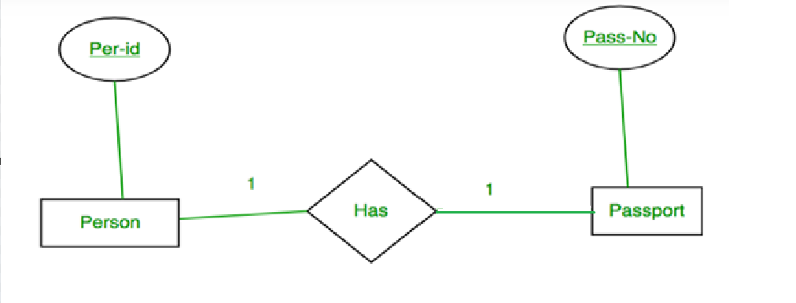
Binary relationship with cardinality ratio 1:1, partial participation
Per-Id | Other Person Attribute | Pass-No
Pass-No | Other Person Attribute

Slide 13
Conversion of ER to Relational Table
Binary Relationships With Cardinality Ratios
Binary relationship with cardinality ratio 1:m
A directed line from the relationship set counselor to the entity set faculty and an undirected line to the entity set student as shown in the below figure, indicates that a faculty may counsel many students, but a student may have at most one counselor.
FACULTY
Faculty_ID Faculty_Name Faculty_Designation Faculty _Sal Faculty_DOB Faculty_MobileNo Dept_ID
Counselor
Student
Student_RegNo Student_Name Student_DOB Student_Location Dept_ID

Slide 14
Conversion of ER to Relational Table
Binary Relationships With Cardinality Ratios
Binary relationship with cardinality ratio m:1
An undirected line from the relationship set counselor to the entity set faculty and a directed line to the entity set student as shown in the below figure, indicates that a faculty may counsel at most one student, but a student may have many counselors.
FACULTY
Faculty_ID Faculty_Name Faculty_Designation Faculty _Sal Faculty_DOB Faculty_MobileNo Dept_ID
Counselor
Student
Student_RegNo Student_Name Student_DOB Student_Location Dept_ID

Slide 15
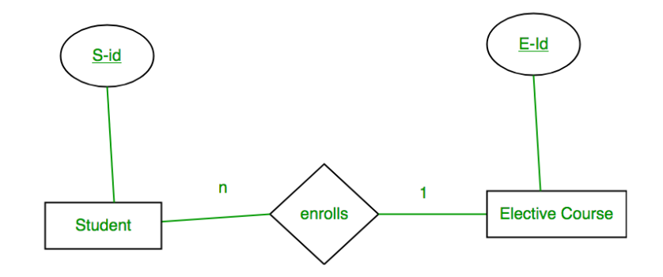
Binary relationship with cardinality ratio 1:m
S-Id | Other Student Attribute | E-Id
E-Id | Other Elective CourseAttribute

Slide 16
Conversion of ER to Relational Table
Binary Relationships With Cardinality Ratios
Binary relationship with cardinality ratio m:m
We draw an undirected line from the relationship set counselor to both entity sets faculty and student as shown in the below figure, indicates that a faculty may counsel many students, and a student may have many counselor.
FACULTY
Faculty_ID Faculty_Name Faculty_Designation Faculty _Sal Faculty_DOB Faculty_MobileNo Dept_ID
Counselor
Student
Student_RegNo Student_Name Student_DOB Student_Location Dept_ID

Slide 17
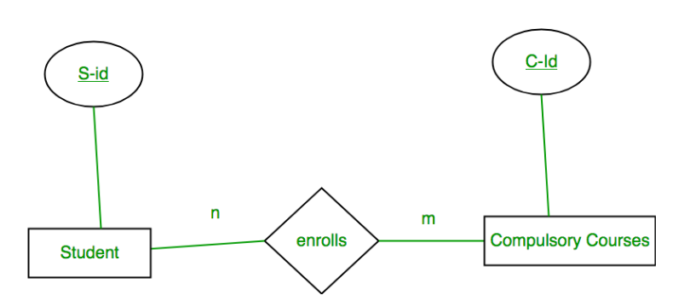
Binary relationship with cardinality ratio m:m
Student |  |  | Enrolls |  |  | Compulsory_Courses
S-Id | Other Student Attribute |  | S-Id | C-Id |  | C-Id | Other Compulsory CourseAttribute
S1 | – |  | S1 | C1 |  | C1 | –
S2 | – |  | S1 | C2 |  | C2 | –
S3 | – |  | S3 | C1 |  | C3 | –
S4 | – |  | S4 | C3 |  | C4 | –
 |  |  | S4 | C2
 |  |  | S3 | C3

Slide 18
Conversion of ER to Relational Table
Binary Relationship With Both Cardinality Constraints and Participation Constraints
Because of the total participation constraint, foreign key acquires NOT NULL constraint
Now foreign key can not be null.
Option 1: For Binary Relationship With Cardinality Constraint and Total Participation Constraint From One Side
Because cardinality ratio = 1 : n , so we will combine the entity set B and relationship set R.
Then, two tables will be required-
A ( a1 , a2 )
BR ( a1 , b1 , b2 )
Because of total participation, foreign key a1 has acquired NOT NULL constraint, so it can’t be null now.
a1
a2
b1
b2
A
1
R
m
B

Slide 19
Conversion of ER to Relational Table
Binary Relationship With Both Cardinality Constraints and Participation Constraints
Option 2: Binary Relationship With Cardinality Constraint and Total Participation Constraint From Both Sides
If there is a key constraint from both the sides of an entity set with total participation, then that binary relationship is represented using only single table.
ARB ( a1 , a2 , b1 , b2 )
a1
a2
b1
b2
m
R
m
A
B

Slide 20
Conversion of ER to Relational Table
Binary Relationship With Weak Entity Set
Weak entity set always appears in association with identifying relationship with total participation constraint.
Here, two tables will be required-
A ( a1 , a2 )
BR ( a1 , b1 , b2 )
a1
a2
b1
b2
m
R
A
m
B

Slide 21
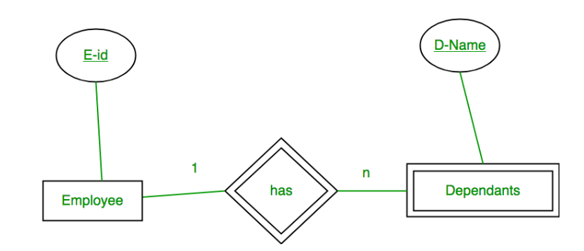
Binary Relationship With Weak Entity Set
E-Id | Other Employee Attribute
D-Name | E-Id | Other Dependents Attribute

Slide 22
Pitfalls in Relational database
Pitfalls in Relational Database
Relational database design requires that we find a “good” collection of relation schemas.
A bad design may lead to
Repetition of information.
Inability to represent certain information.
Design Goals:
Avoid redundant data
Ensure that relationships among attributes are represented
Facilitate the checking of updates for violation of database integrity constraints

Slide 23
Pitfalls in Relational database
Example
Consider the relation schema:
Lending-schema = (branch_name, branch_city, assets,
customer_name, loan_number, amount)
Redundancy:
Data for branch-name, branch-city, assets are repeated for each loan that a branch makes
Wastes space and complicates updating
Null values
Cannot store information about a branch if no loans exist
Can use null values, but they are difficult to handle

Slide 24
Pitfalls in Relational database, Decomposing bad schema
Decomposition
Repetition of information will lead to many issues, that type of schema is a bad design. To avoid such issues the designed schema is decomposed into two or more schemas.
Consider the schema : Lending_schema
Lending_schema is decomposed into two schemas as given below
Branch-customer-schema = (branch_name, branch_city, assets, customer_name)
Customer-loan-schema = (customer_name, loan_number, amount)

Slide 25
Pitfalls in Relational database, Decomposing bad schema
Decomposition
All attributes of an original schema (R) must appear in the decomposition (R1, R2):
R = R1 ∪ R
Lossless-join decomposition. For all possible relations r on schema R.
r = ΠR1 (r) ΠR2 (r)

Slide 26
Pitfalls in Relational database, Decomposing bad schema
Decomposition
Example :
Consider The relation : R = (A,B)
Decomposition of R = R1(A) and R2(B)
R
ΠA (R)
ΠB(R)
ΠA (R) ΠB(R)
A | B
X | 1
X | 2
Y | 1
A
X
Y
B
1
2
A | B
X | 1
X | 2
Y | 1
Y | 2

Slide 27
Relational Model Languages
Relational Algebra
Relational Calculus
Tuple relational Calculus
Domain Relational Calculus

Slide 28
Relational Algebra – Fundamental Operators and syntax
Relational algebra is a procedural query language.
provides a theoretical foundation for relational databases and SQL
define operators that transform one or more input relations into an output relation
An operator can be either unary or binary
Relational algebra is performed recursively on a relation and intermediate results are also considered relations.
Fundamental operations of Relational Algebra
Select Operation (σ)
Project Operation (∏)
Set Operations
Union Operation (∪)
Intersection (∩)
Set Difference (−)
Join Operation (⋈)
Cartesian Product (Χ)
Rename Operation (ρ)
Assignment Operation (←)

Slide 29
Relational Algebra – Fundamental Operators and syntax
Select Operation (σ)
It retrieves the records that satisfy the given predicate from a relation
Notation : σ_{p}(r)
Where
σ - Selection Predicate
r – Relation
p – Prepositional logic formula
Example 1: σ_{JOB = “MANAGER"}(EMP)
Output : Retrieve the records from emp where job is manager
Example 2 : σJOB = “MANAGER" and DEPTNO = 20(EMP)
Output : Retrieve the records from emp where job is manger and deptno is 20.

Slide 30
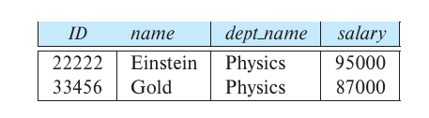




Example
select those tuples of the instructor relation where the instructor is in the “Physics” department.
find all instructors with salary greater than $90,000
find the instructors in Physics with a salary greater than $90,000
find all departments whose name is the same as their building name

Slide 31
Relational Algebra – Fundamental Operators and syntax
Project Operation (∏)
It projects column(s) that satisfy a given predicate.
Notation : ∏_{A1, A2,…, An} (r)
Where
∏ - Predicate
A1,A2,…,An – Attribute names of a relation
r – Relation
Note : Because of relation is a set duplicate rows are eliminated
automatically.
Example : ∏_{ENAME, JOB} (EMP)
Output : It selects and projects the column named as ename and job from emp table

Slide 32
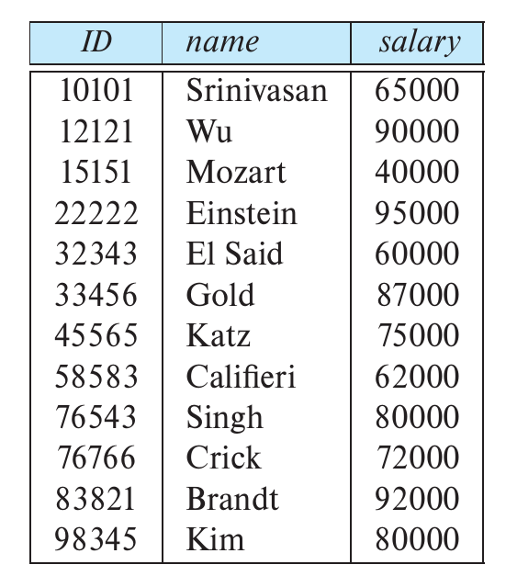


Example

Slide 33

Composition of Relational Operations
Find the names of all instructors in the Physics department

Slide 34
SET Operations
Union
Intersection
Set-Difference

Slide 35
Relational Algebra – Fundamental Operators and syntax
Union Operation (∪)
It performs binary union between two given relations.
It is defined as
r ∪ s = { t | t ∈ r or t ∈ s}
Notation : r U s
Where
U is the union operator
R and S are relations
The following conditions must hold from both relations to make the union operation is true
Relations R and S should have the same number of Attributes
The Attributes domain values (data types) must be compatible
Duplicate records will be eliminated automatically

Slide 36
Relational Algebra – Fundamental Operators and syntax
Union Operation (∪)
Consider the following table
Example : AUB
Example : BUA
F1 F2
30 C
10 A
B
D
50 E
Records in table a
Sql > Select * from a
F1 F2
30 C
10 A
20 B
Records in table b
Sql > Select * from b;
ID NAME
30 C
40 D
50 E
ID NAME
10 A
20 B
30 C
40 D
50 E

Slide 37
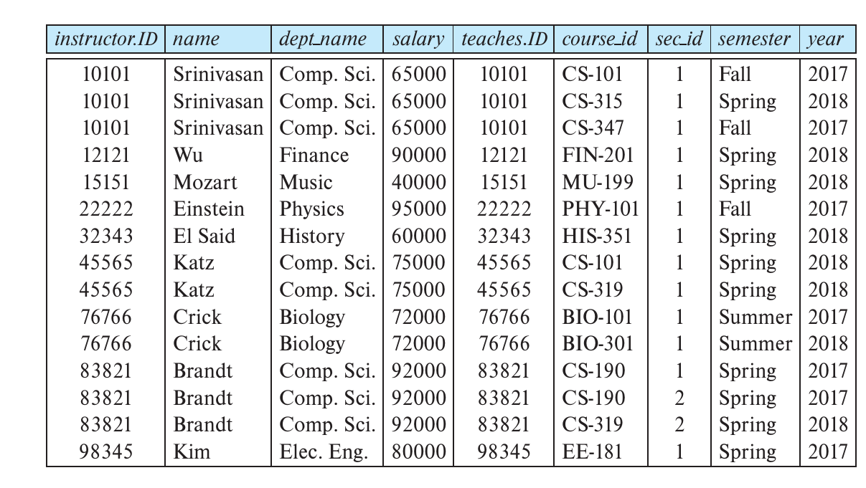

Slide 38
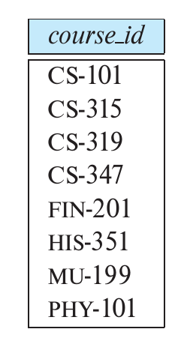


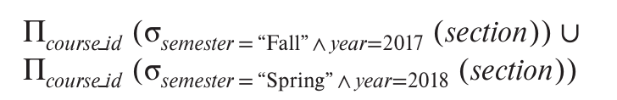
Union Examples
Find the set of all courses taught in the Fall 2017 semester
Find the set of all courses taught in the Spring 2018 semester
Find the set of all Courses offered in either Fall 2017, Spring 2018, or both semesters.

Slide 39
Relational Algebra – Fundamental Operators and syntax
INtersection Operation (∩)
Consider the following table
Example : A∩B
Example : B∩A
Records in table a
Sql > Select * from a
F1 F2
30 C
10 A
20 B
Records in table b
Sql > Select * from b;
ID NAME
30 C
40 D
50 E
F1 F2
30 C
ID NAME
30 C

Slide 40
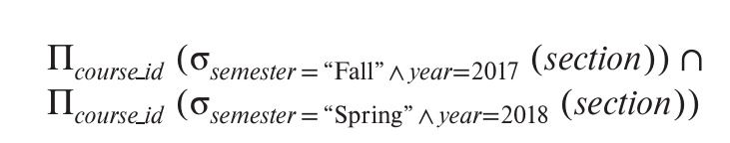
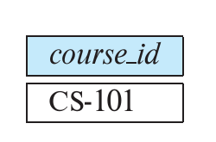
Intersection Examples
Courses offered in both the Fall 2017 and Spring 2018 semesters.

Slide 41
Relational Algebra – Fundamental Operators and syntax
Set Difference (−)
The result of set difference operation is tuples, which are present in one relation but are not in the second relation.
Notation : r − s
Example : Consider the following tables
F1 F2
10 A
B
Records in table a
Sql > Select * from a
F1 F2
30 C
10 A
20 B
Records in table b
Sql > Select * from b;
ID NAME
30 C
40 D
50 E
Example : A-B
ID NAME
40 D
50 E
Example : B-A

Slide 42
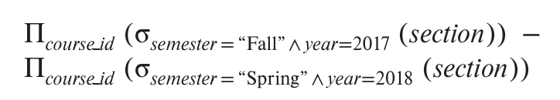
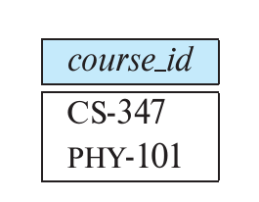
Set Difference Example
Find all the courses taught in the Fall 2017 semester but not in Spring 2018 semester

Slide 43
Relational Algebra – Fundamental Operators and syntax
Cartesian Product (Χ)
Combines information of two different relations into one.
For each and every record in the first query , all the records will be executed in the second query
Notation : r Χ s
Where r and s are relations and their output will be defined as :
r Χ s = { q t | q ∈ r and t ∈ s}
Example : Consider the following tables
A Χ B
F1 | F2 | ID | NAME
10 | A | 30 | C
20 | B | 30 | C
30 | C | 30 | C
10 | A | 40 | D
20 | B | 40 | D
30 | C | 40 | D
10 | A | 50 | E
20 | B | 50 | E
30 | C | 50 | E
Records in table a
Sql > Select * from a
F1 F2
30 C
10 A
20 B
Records in table b
Sql > Select * from b;
ID NAME
30 C
40 D
50 E

Slide 44

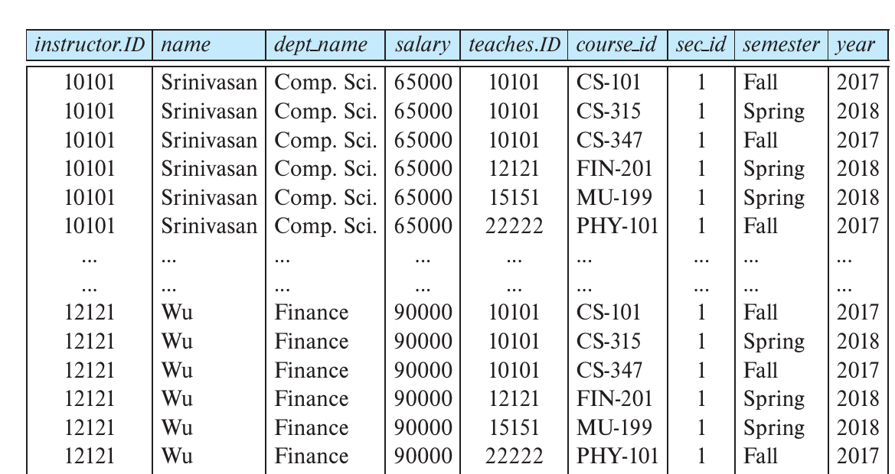

Slide 45
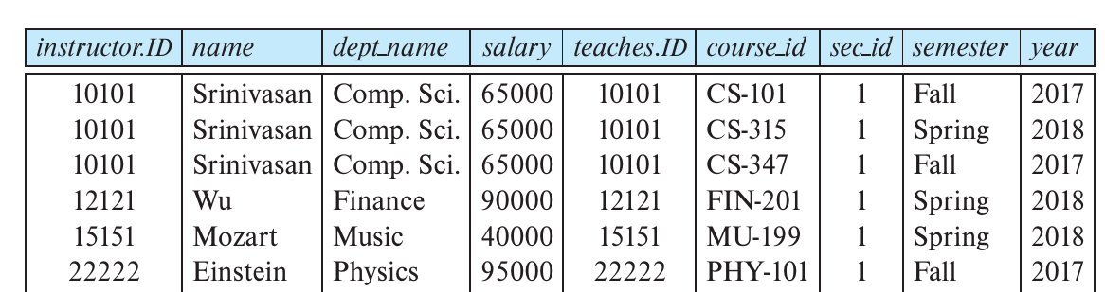

Slide 46
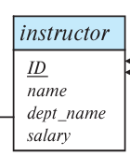
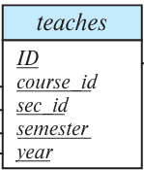
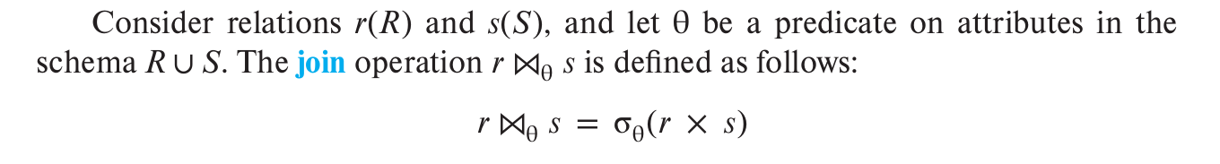
Join Operation
The join operation allows us to combine a selection and a Cartesian product into a single operation.
To select the course taught by the instructor using Join operation

Slide 47
Relational Algebra – Fundamental Operators and syntax
Rename Operation (ρ)
The rename operation allows us to rename the output relation.
Notation : ρ _{x} (E)
Where the result of expression E is saved with name of x.
ρnewname,newbranch(∏name,branch( student))

Slide 48
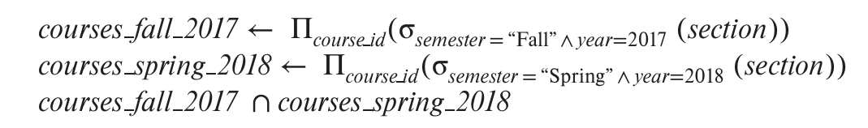
Assignment Operation (←)
The assignment operation is used to write a relational-algebra expression by assigning parts of it to temporary relation variables.

Slide 49
Tuple Relational Calculus

Slide 50
Relational algebra queries, Tuple relational calculus
Relational algebra queries
Example Queries 1:
Find the empno, ename, job, salary for employess whose salary is greater than Rs.2000
{t | t ∈ emp ∧ t[sal] > 2000}
Suppose that we want only the empno attribute, rather than all attributes of the emp relation.
To write this query in the tuple relational calculus, we need to write an expression for a relation on the schema (empno). We need those tuples on (empno) , such that there is a tuple in emp with the sal attribute > 2000.
To express this request, we need the construct “there exists” from mathematical logic.
The notation: ∃ t ∈ r (Q(t))
means “there exists a tuple t in relation r such that predicate Q(t) is true.”

Slide 51
Relational algebra queries, Tuple relational calculus
Using the above notation, we can write the query “Find the empno for each employee with a salary greater than Rs.2,000” as:
{t | ∃ s ∈ emp (t[empno] = s[empno] ∧ s[sal] > 2000)}
In English, the above expression is read as
“The set of all tuples t such that there exists a tuple s in relation emp for which the values of t and s for the empno attribute are equal, and the value of s for the sal attribute is greater than Rs.2,000.”
Tuple variable t is defined on only the empno attribute, since that is the only attribute having a condition specified for t. Thus, the result is a relation on (empno).

Slide 52
Relational algebra queries, Tuple relational calculus
Relational algebra queries
Example Queries 2:
Consider the query “Find the names of all employees whose department is in the location “CHICAGO.” This query is slightly more complex than the previous queries, since it involves two relations: emp and dept.
It requires is that we have two “there exists” clauses in our tuple-relational-calculus expression, connected by and (∧).
We write the query as follows:
{t | ∃ s ∈ emp (t[ename] = s[ename]
∧ ∃ u ∈ dept (u[dname] = s[dname]
∧ u[building] = “CHICAGO”))}
Tuple variable u is restricted to departments that are located in the chicago, while tuple variable s is restricted to emp whose dept name matches that of tuple variable u.

Slide 53
Relational algebra queries, Tuple relational calculus
Tuple Relational Calculus
The tuple relational calculus is a nonprocedural query language.
It describes the desired information without giving a specific procedure for obtaining that information.
A query in the tuple relational calculus is expressed as:
{t | P(t)}
That is, it is the set of all tuples t such that predicate P is true for t.
we use t[A] to denote the value of tuple t on attribute A, and we use t ∈ r to denote that tuple t is in relation r.

Slide 54
Relational algebra queries, Tuple relational calculus
Tuple Relational Calculus
Formal definition
A tuple-relational-calculus expression is of the form:
{t|P(t)}
where P is a formula.
Several tuple variables may appear in a formula. A tuple
variable is said to be a free variable unless it is quantified by a ∃ or ∀.
Thus, in:
t ∈ emp ∧ ∃ s ∈ dept(t[dname] = s[dname])
t is a free variable.
Tuple variable s is said to be a bound variable.

Slide 55
Relational algebra queries, Tuple relational calculus
A tuple-relational-calculus formula is built up out of atoms. An atom has one of the following forms:
s ∈ r, where s is a tuple variable and r is a relation (we do not allow use of the ∈/ operator).
s[x] u[y], where s and u are tuple variables, x is an attribute on which s is defined, y is an attribute on which u is defined, and is a comparison operator (<, ≤, =, =, >, ≥); we require that attributes x and y have domains whose members can be compared by (-)
s[x] c, where s is a tuple variable, x is an attribute on which s is defined, is a comparison operator, and c is a constant in the domain of attribute x.

Slide 56
Relational algebra queries, Tuple relational calculus
We build up formulae from atoms by using the following rules:
An atom is a formula.
If P1 is a formula, then so are ¬P1 and (P1).
If P1 and P2 are formulae, then so are P1 ∨ P2, P1 ∧ P2, and P1 ⇒ P2.
If P1(s) is a formula containing a free tuple variable s, and r is a relation, then
∃ s ∈ r (P1(s)) and ∀ s ∈ r (P1(s))
are also formulae.

Slide 57
Relational algebra queries, Tuple relational calculus
branch (branch_name, branch_city, assets )
customer (customer_name, customer_street, customer_city )
account (account_number, branch_name, balance )
loan (loan_number, branch_name, amount )
depositor (customer_name, account_number )
borrower (customer_name, loan_number )

Slide 58
Relational algebra queries, Tuple relational calculus
Banking Examples
Find the loan_number, branch_name, and amount for loans of over $1200
{t | t ∈ loan ∧ t [amount ] > 1200}
Find the loan number for each loan of an amount greater than $1200
{t | ∃ s ∈ loan (t [loan_number ] = s [loan_number ] ∧ s [amount ] > 1200)}
Notice that a relation on schema [loan_number ] is implicitly defined by
the query

Slide 59
Relational algebra queries, Tuple relational calculus
Banking Examples
Find the names of all customers having a loan, an account, or both at the bank
{t | ∃s ∈ borrower ( t [customer_name ] = s [customer_name ]) ∨ ∃u ∈ depositor ( t [customer_name ] = u [customer_name ])
Find the names of all customers who have a loan and an account at the bank
{t | ∃ s ∈ loan (t [loan_number ] = s [loan_number ] ∧ s [amount ] > 1200)}
{t | ∃s ∈ borrower ( t [customer_name ] = s [customer_name ]) ∧ ∃u ∈ depositor ( t [customer_name ] = u [customer_name] )

Slide 60
Relational algebra queries, Tuple relational calculus
Banking Examples
Find the names of all customers having a loan at the Perryridge branch
{t | ∃s ∈ borrower (t [customer_name ] = s [customer_name ] ∧ ∃u ∈ loan (u [branch_name ] = “Perryridge” ∧ u [loan_number ] = s [loan_number ]))}
Find the names of all customers who have a loan at the Perryridge branch, but no account at any branch of the bank
{t | ∃s ∈ borrower (t [customer_name ] = s [customer_name ] ∧ ∃u ∈ loan (u [branch_name ] = “Perryridge” ∧ u [loan_number ] = s [loan_number ])) ∧ not ∃v ∈ depositor (v [customer_name ] = t [customer_name ])}

Slide 61
Relational algebra queries, Tuple relational calculus
Safety of Expressions
It is possible to write tuple calculus expressions that generate infinite relations.
For example, { t | ¬ t ∈ r } results in an infinite relation if the domain of any attribute of relation r is infinite
To guard against the problem, we restrict the set of allowable expressions to safe expressions.
An expression {t | P (t )} in the tuple relational calculus is safe if every component of t appears in one of the relations, tuples, or constants that appear in P
NOTE: this is more than just a syntax condition.
E.g. { t | t [A] = 5 ∨ true } is not safe --- it defines an infinite set with attribute values that do not appear in any relation or tuples or constants in P.

Slide 62
Domain Relational Calculus
A second form of relational calculus, called domain relational calculus, uses domain variables that take on values from an attributes domain, rather than values for an entire tuple. The domain relational calculus,
However, is closely related to the tuple relational calculus.
Domain relational calculus serves as the theoretical basis of the widely used QBE language, just as relational algebra serves as the basis for the SQL language.

Slide 63
Domain Relational Calculus
An expression in the domain relational calculus is of the form
{< x1, x2,..., xn > | P(x1, x2,..., xn)}
where x1, x2,..., xn represent domain variables. P represents a formula composed of atoms, as was the case in the tuple relational calculus.

Slide 64
Domain Relational Calculus
An atom in the domain relational calculus has one of the following forms:
< x1, x2,..., xn > ∈ r, where r is a relation on n attributes and x1, x2,..., xn are domain variables or domain constants.
x y, where x and y are domain variables and is a comparison operator (<, ≤, =, =, >, ≥). We require that attributes x and y have domains that can be compared by (-).
x c, where x is a domain variable, is a comparison operator, and c is a constant in the domain of the attribute for which x is a domain variable.

Slide 65
Domain Relational Calculus
Example Queries
Find the loan_number, branch_name, and amount for loans of over $1200
{< l, b, a > | < l, b, a > ∈ loan ∧ a > 1200}
Find the names of all customers who have a loan of over $1200
{< c > | ∃ l, b, a (< c, l > ∈ borrower ∧ < l, b, a > ∈ loan ∧ a > 1200)}
Find the names of all customers who have a loan from the Perryridge branch and the loan amount:
{< c, a > | ∃ l (< c, l > ∈ borrower ∧ ∃b (< l, b, a > ∈ loan ∧
b = “Perryridge”))}
{< c, a > | ∃ l (< c, l > ∈ borrower ∧ < l, “ Perryridge”, a > ∈ loan)}

Slide 66
Domain Relational Calculus
Example Queries
Find the names of all customers having a loan, an account, or both at the Perryridge branch:
{< c > | ∃ l ( < c, l > ∈ borrower ∧ ∃ b,a (< l, b, a > ∈ loan ∧ b = “Perryridge”)) ∨ ∃ a (< c, a > ∈ depositor ∧ ∃ b,n (< a, b, n > ∈ account ∧ b = “Perryridge”))}
Find the names of all customers who have an account at all branches located in Brooklyn:
{< c > | ∃ s,n (< c, s, n > ∈ customer) ∧
∀ x,y,z (< x, y, z > ∈ branch ∧ y = “Brooklyn”) ⇒ ∃ a,b (< x, y, z > ∈ account ∧ < c,a > ∈ depositor)}

Slide 67
Safety of Expressions
The expression:
{ < x₁, x₂, …, x_{n} > | P (x₁, x₂, …, x_{n} )}
is safe if all of the following hold:
All values that appear in tuples of the expression are values from dom (P ) (that is, the values appear either in P or in a tuple of a relation mentioned in P ).
For every “there exists” subformula of the form ∃ x (P₁(x )), the subformula is true if and only if there is a value of x in dom (P₁) such that P₁(x ) is true.
For every “for all” subformula of the form ∀_{x} (P₁ (x )), the subformula is true if and only if P₁(x ) is true for all values x from dom (P₁).

Slide 68
THANK YOU

